Slide 1

Healthcare
Persistency of a drug
Data Science project
August 2021

Slide 2
COOL DATA SCIENTISTS TEAM
Name | Email | Country | College / Company | Specialization
Yousef Elbayoumi | yousefxelbayomi@gmail.com | Palestine | Bahçeşehir University | Data Science
Mukhammadjon Kholmirzev | kmukhammadjon@gmail.com | Uzbekistan | Ulsan National Institute of Science and Technology | Data Science
Jamila hamdi | jamila.hamdi90@gmail.com | Tunisia | Faculty of science and managment | Data Science
H. Melis Tekin Akcin | meliss85@gmail.com | UK | Hacettepe University | Data Science

Slide 3

Contents
Background
Data Intake Report
Statistical Analysis
Hypotethis & Data Visualization
Recomendations
Conclusion

Slide 4
Background
Problem Statement:
One of the challenges for Pharmaceutical companies is to understand the persistency of drug as per the physician prescription. This issue results in a bad impact on the pharmacies for all the categories; patients, physicians, and administration. However, the team of data scientist is capable of discovering the analyzing the dataset and detecting the factors that are impacting the primary factor which is the "persistency". By building a classification machine learning model, we will be able to classify the dataset and find the variables that affect the target variables "Persistency Flag".
Business Understanding:
In this project, our aim is to examine the persistency of drug.
To have a better business understanding, our aim is to understand our dataset deeply. We will examine the features to gather some more knowledge, we will find relationships between the features and their effects on our target variable.
We will look at the demographics, clinical factors, provider attributes and disease/treatment factors.
Then our goal is to create a model to decide whether a given drug is persistent as per the physician’s prescription. To do that, we will do some feature engineering and decide which of the features effects the drug persistency.
After applying different models, we will decide which model fits best to our dataset.

Slide 5
Data Intake
Name: Healthcare- Persistency of a drug
Report date: <20.07.2021>
Internship Batch:<LISUM01>
Version:<1.0>
Data intake by: Yousef Elbayoumi, Mukhammadjon Kholmirzev, Jamila Hamdi, H. Melis Tekin Akcin
Total number of observations | 3424
Total number of files | 1
Total number of features | 69
Base format of the file | .xlsx
Size of the data | 899 KB
Proposed Approach
Perform Exploratory Data Analysis on the data set
Perform data preprocessing such as deleting null values, remove duplicates lines and checking for outliers.
Transforming data
Apply different machine learning models and test them in order to find the best model

Slide 6
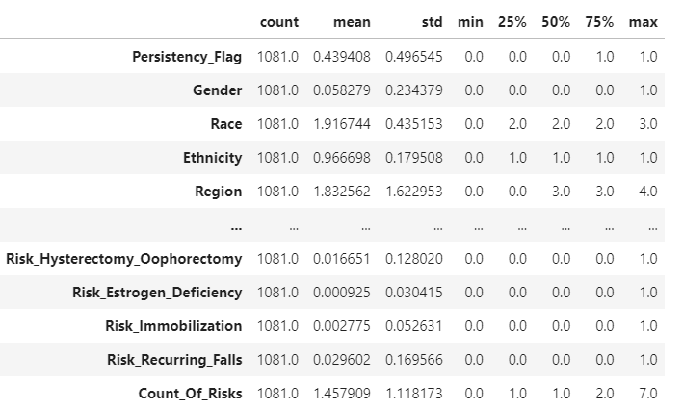
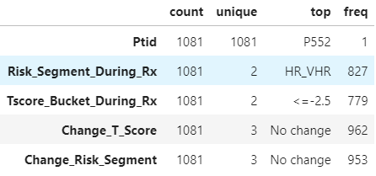
Statistical Analysis
Statistics for numerical Features
Statistics for categorical features

Slide 7
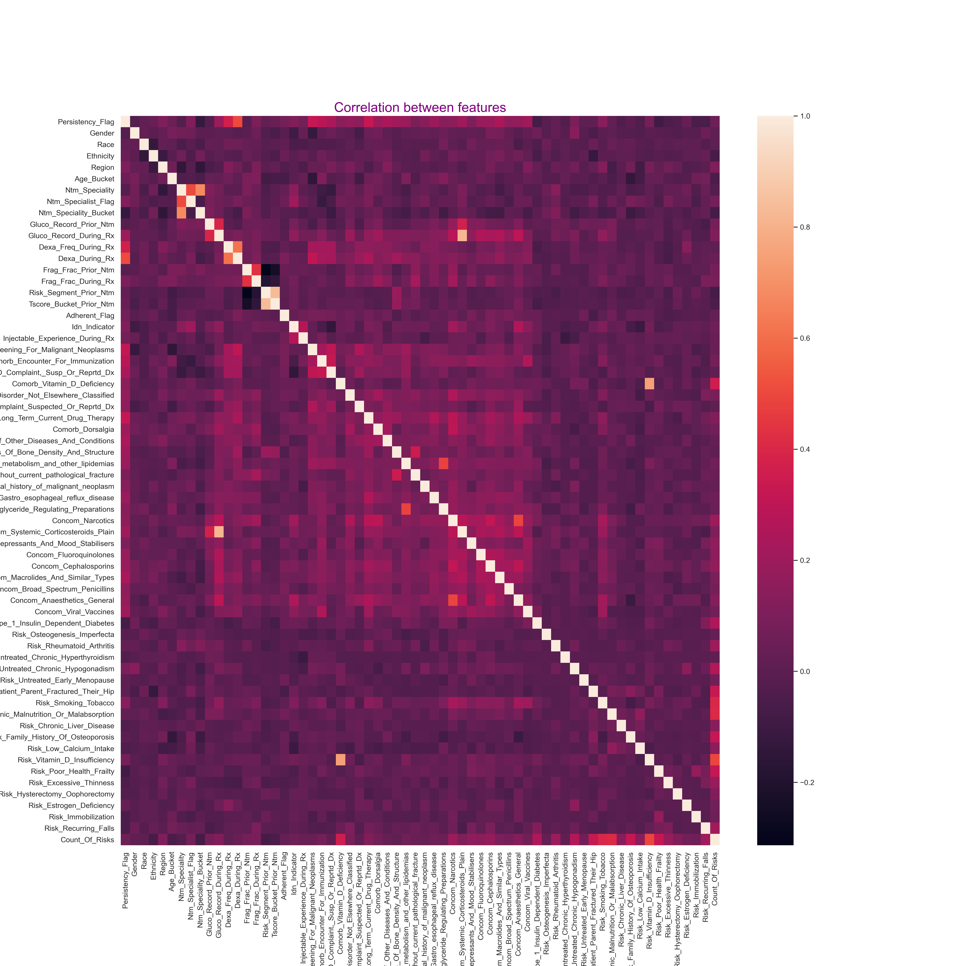
Correlation Analysis

Slide 8
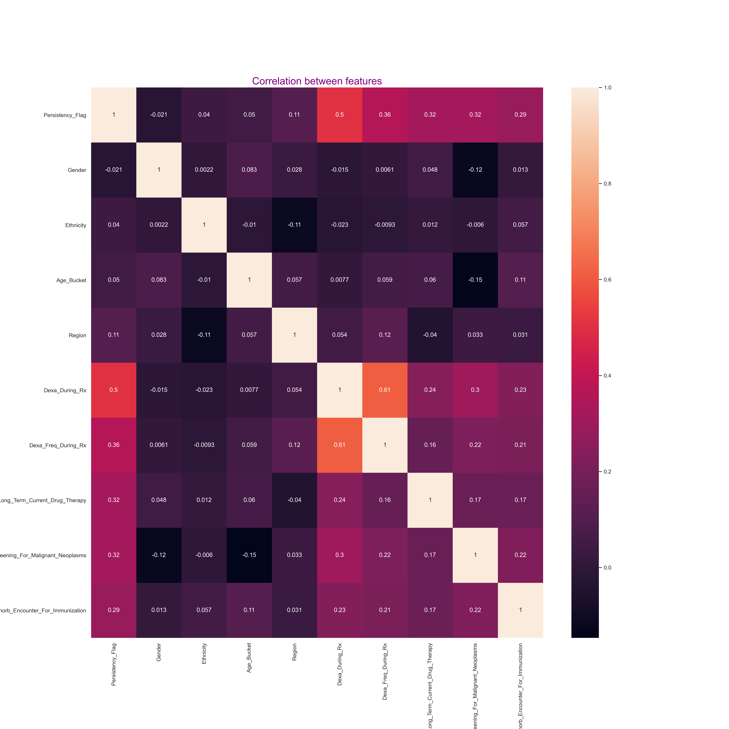
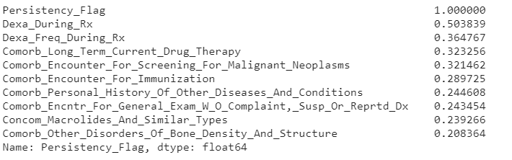
Correlation Analysis
Correlation of features to the target
Top 10 most correlated features to the target

Slide 9
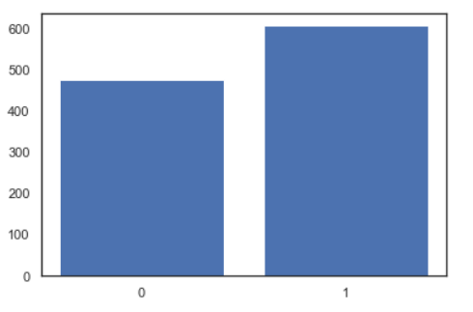
Profit Analysis
Hypotethis & Data Visualization
Checking the ratio of the target variable

Slide 10
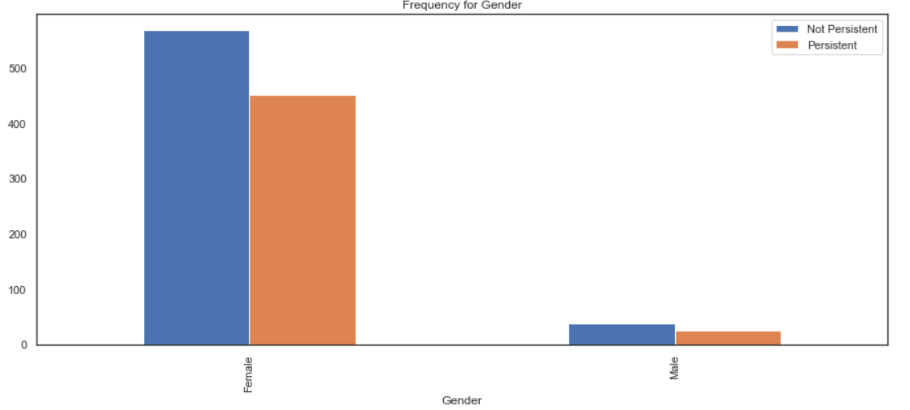
Profit Analysis
Hypotethis & Data Visualization
Gender wise Analysis
As you can see from the graph, a huge imbalance between the genders

Slide 11
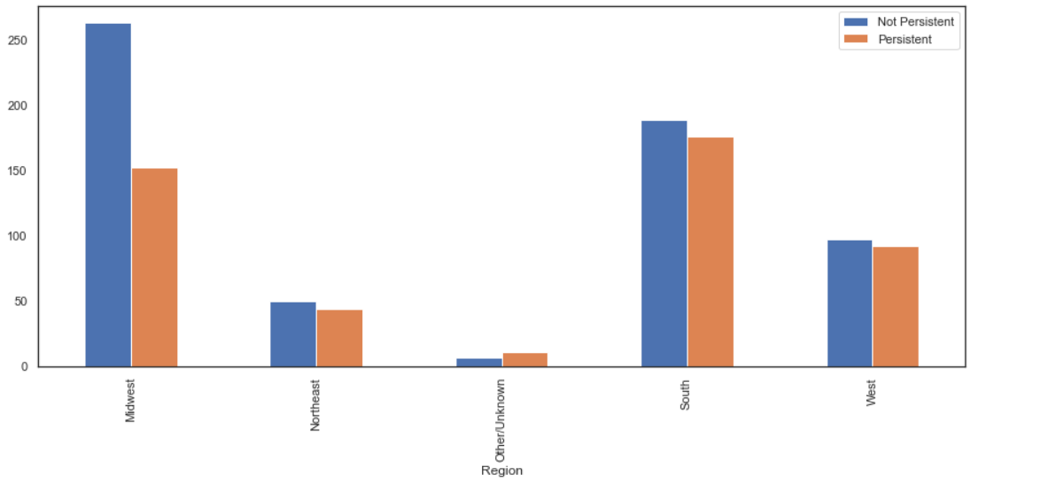
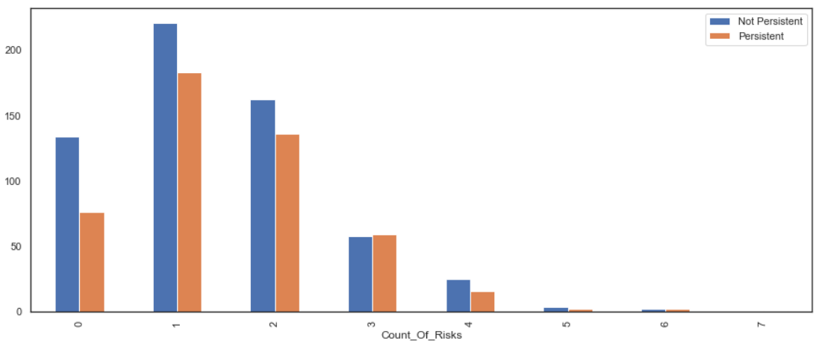
Hypotethis & Data Visualization

Slide 12
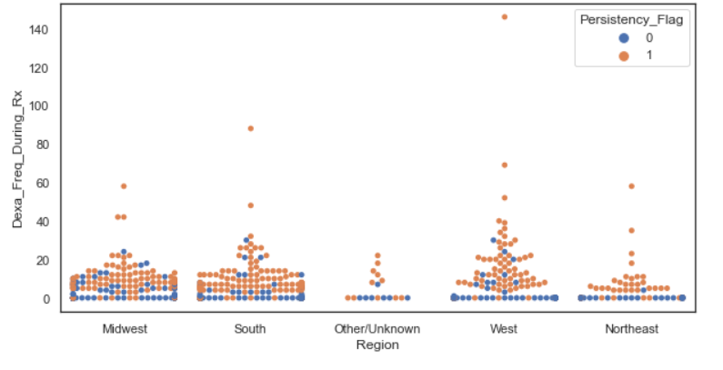
Profit Analysis
Hypotethis & Data Visualization
Number of DEXA scans by each region

Slide 13
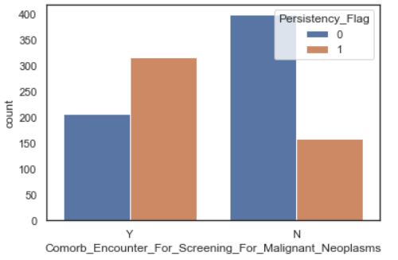
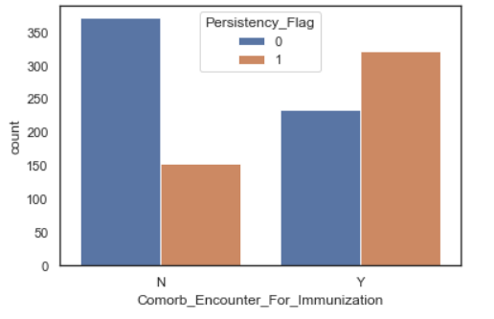
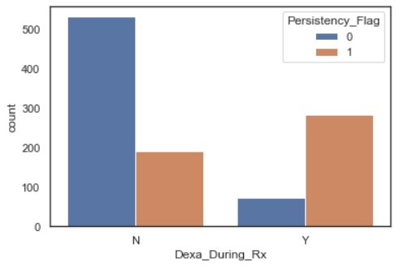
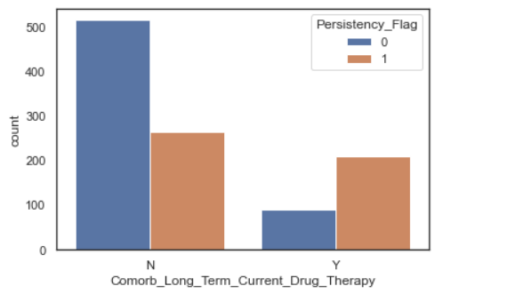
Hypotethis & Data Visualization
There are similar result cunts on features: ‘Dexa_During_Rx’, ‘Comorb_Long_Term_Current_Drug_Therapy’ and ‘Comorb_Encounter_For_Immunization’ has more persistency on ‘yes’ values.

Slide 14

Recommended models

Slide 15
Thank You

